Slide 1
Datawarehouse Concepts
Presented By:
Hitesh Bhatt

Slide 2
WHAT IS DATABASE ?
Database is an organized collection of data/ Information on a particular subject so that it can easily be accessed, managed or updated.
Database uses OLTP (Online Transaction Processing) which enables the real-time execution of large numbers of database transactions.
E.g. TABLE: CUSTOMER_INFO
COLUMNS OR FIELDS
CUST_ID | CUST_NAME | CUST_CITY | CUST_PHONE
1001 | Hitesh | Pithoragarh | 99xxxxxxxx
1002 | Chandan | Kolkata | 98xxxxxxx
RECORDS
NOTE: Data stored in Database is up-to-date.

Slide 3
DATA WAREHOUSE

Slide 4
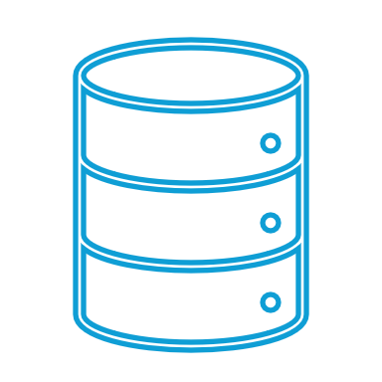
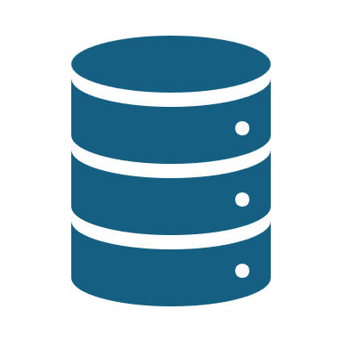

What is DATA WAREHOUSE?
Data warehousing is like a relational database designed for analytical needs.
It stores current data as well as Historical data, thus uses the OLAP(Online Analytical Processing) .
Tables and joins are simple in Data warehouse as they are de-normalized.
It stores data from multiple sources (database, Flat files, excel) locations
Database
Data warehouse
Flat files

Slide 5

DATA MARTS
DATA Marts are subset of data warehouse focus on a specific subject.
It reduce User’s response time due to reduce in volume of data.
Data can be segmented and stored on different hardware/software platforms.
Data Marts 1
Database
Data warehouse
Data Mart 2
Flat Files
Data Marts 3

Slide 6

Operational data Store(ODS)
ODS is a database that is used for transactional processing. And act as a source to Datawarehouse .
The data in ODS is the raw data.
It lies between source and the target(Data warehouse, Data marts) i.e in staging layer.
Data Marts 1
Database
Data warehouse
ODS
Data Mart 2
Flat Files
Data Marts 3

Slide 7
STAR SCHEMA
A star schema is the elementary form of a dimensional model, in which data are organized into facts and dimensions.
Center of the schema consists of a large fact table, and the points of the star are the dimension tables.
Dimension Tables are de-normalized.
DIMENSION TABLES
DIMENSION TABLES
FACT
TABLE
DIMENSION TABLES
DIMENSION TABLES

Slide 8
SNOWFLAKE SCHEMA
Snowflake schema is an extension of star schema where the dimension tables are Normalized.
The performance of SQL queries is a bit less when compared to star schema as a greater number of joins are involved.
DIMENSION TABLES
DIMENSION TABLES
SUB-DIMENSION TABLES
FACT
TABLE
SUB-DIMENSION TABLES
DIMENSION TABLES
DIMENSION TABLES

Slide 9
Fact and Dimension Tables
A fact table stores quantitative information for analysis and joins dimension tables using Foreign Key realtionship.
For E.g. Every sale made is a fact that happens, and the fact table is used to record these facts.
Product ID | Customer ID | Unit Sold
17 | 2 | 1
21 | 3 | 2
4 | 1 | 1
Dimension table gives the descriptive information about the measures used in fact table .
Customer ID | Name | Gender | Income | Education | Region
1 | Brian Edge | M | 2 | 3 | 4
2 | Fred Smith | M | 3 | 5 | 1
3 | Sally Jones | F | 1 | 7 | 3

Slide 10
Types of Dimensions
A. Slowly Changing Dimension:
Slowly Changing Dimensions (SCD) - dimensions that change slowly over time a period, rather than changing on regular schedule. In Data Warehouse there is a need to track changes in dimension attributes in order to report historical data.
Type I: is used to overwrite the old values but the disadvantage is that no history is captured.
Type II: is used to add a new row or maintains different versions of data.
Type III: is used to create a new column. Hence the original data is modified to include a new data.

Slide 11
SCD TYPE I:
SCD TYPE I is used to overwrite the old values but the disadvantage is that no history is captured.
Hence saves cost and space.
Only the new record will be present.
Before change:
After Change:
CUST_ID | CUST_NAME | GENDER | CUST_CITY
1001 | Hitesh Bhatt | Male | Pithoragarh
1002 | Chandan | Male | Kolkata
CUST_ID | CUST_NAME | GENDER | CUST_CITY
1001 | Hitesh Bhatt | Male | Hyderabad
1002 | Chandan | Male | Kolkata

Slide 12
SCD TYPE II:
SCD Type2 is used to add a new row or maintains different versions of data.
Hence History is maintained
It contains the old model phone as well as new model phone details.
Before change:
After Change:
CUST_ID | CUST_NAME | GENDER | CUST_CITY
1001 | Hitesh Bhatt | Male | Pithoragarh
1002 | Chandan | Male | Kolkata
CUST_ID | CUST_NAME | GENDER | CUST_CITY | DW_START_DT | DW_END_DT | CURR_IND
1001 | Hitesh Bhatt | Male | Pithoragarh | 2-May-2024 | 31-Dec-00 | Y
1002 | Chandan | Male | Kolkata | 2-May-2024 | 3-May-2024 | N
1002 | Chandan | Male | Pune | 3-May-2024 | 31-Dec-00 | Y

Slide 13
SCD TYPE III
SCD Type3 is used to create a new column. Hence the original data is modified to include a new data.
It will add a new Column as Old Phone and New Phone to keep the track of record.
Before Change:
After Change:
CUST_ID | CUST_NAME | GENDER | CUST_CITY
1001 | Hitesh Bhatt | Male | Pithoragarh
1002 | Chandan | Male | Kolkata
CUST_ID | CUST_NAME | GENDER | Old city | CUST_CITY
1001 | Hitesh Bhatt | Male | Pithoragarh | Hyderabad
1002 | Chandan | Male | Kolkata | Kolkata

Slide 14
Types of Dimensions
B. Conformed Dimension: Table which is used by more than one fact table.
Example: DATE_DIM can be used as a conformed Dimension because its attributes (day, week, months, etc.) have the same meaning when joined to any fact table.
For E.g:
C. Degenerate Dimension: is a dimension key in the fact table that does not have its own Dimension table.
Example: Policy number, order number, Invoice number Used to track the transactions or grouping items.
Date | Wid | Day | Month | Year
2024-03-04 | 1001 | 04 | 03 | 2024
2021-08-10 | 1002 | 10 | 08 | 2021

Slide 15
Types of Dimensions
D. Junk Dimension: used to store junk attributes like flags, yes/no that are unrelated to any dimension.
E. Role play Dimension: A table with multiple relationships between itself and another table.
Example: Suppose a sales fact table has multiple relationships to time on the keys like order day, Ship Day, close day. So, it will create a time, ship day and close day as a subset of columns from original table.

Slide 16
Types Of Fact Tables
Transaction Fact table:
Is a fact table where event is stored in the fact table only once.
The number of rows is the same as the source table
For E.g. : Suppose a restaurant has Orders for 3 days as shown below
Source
table
Fact table
Source table
Fact table
Source
table
Fact table
80 Orders
80 Orders
80 Orders
70 Orders
80 Orders
70 orders
80 Orders
70 Orders
90 Orders
80 Orders
70 Orders
90 Orders
Monday
Tuesday
Wednesday

Slide 17
B. Periodic Snapshot Fact Table:
Where the whole source system is copied into the fact table regularly
The same event is stored multiple times.
For E.g. : Bank account at the end of each day, the balances of every customer account in the bank is stored in this account balance table.
Everyday we copy the whole content of account balance table into the periodic snapshot table.
Source
table
Fact table
Source
table
Fact table
Source
table
Fact table
20,000
20,000
22,000
20,000
22,000
24,000
20,000
22,000
24,000
Monday
Tuesday
Wednesday

Slide 18
C. Accumulated Fact Table: used to show the activity of a process that has a beginning and an end.
Example: Health Insurance claim
Before Claim:
After Claim:
D. Fact less Fact table: a transaction fact tables which contain no measures. These tables are used to capture the action of the business process.
Example: criminal case is a simple fact with no measures but can have a lot of dimensional attributes associated with the fact.
Start Date | End Date | Cust_name | Cust_city | Amount | Amt_approved
2022-08-07 |  | Hitesh | Hyderabad | 50000
Start Date | End Date | Cust_name | Cust_city | Amount | Amt_approved
2022-08-07 | 2021-07-06 | Hitesh | Hyderabad | 50000 | 20000

